Slide 1

Controlling Mouse Motion Using Eye Tracking
CMR TECHNICAL CAMPUS
UGC AUTONOMOUS
DEPARTMENT OF INFORMATION TECHNOLOGY
(Accredited by NAAC, NBA, Permanently Affiliated to JNTUH, Approved by AICTE, New Delhi) Recognized Under Section 2(f) & 12(B) of the UGC Act.1956,
Kandlakoya (V), Medchal Road, Hyderabad-501401.
2018-2022
Under Guidance:
M. Sivajyothi
(Asst. Professor)
G.Meghana(187R1A1226)
M. Ravi Kumar(187R1A1227)
V. Sri Vinay(187R1A1254)

Slide 2
Table of contents:
ABSTRACT
EXISTING SYSTEM
DISADVANTAGES OF EXISTING SYSTEM
PROPOSED SYSTEM
ADVANTAGES OF PROPOSED SYSTEM
HARDWARE REQUIREMENTS
SOFTWARE REQUIREMENTS
PROJECT ARCHITECTURE

Slide 3
TABLE OF CONTENTS:
MODULES
UML DIAGRAMS
SAMPLE CODE
RESULT
CONCLUSION
FUTURE ENHANCEMENTS
REFERENCES

Slide 4
ABSTRACT:
A high number of people, affected with neurogliomata disabilities or those paralyzed by injury cannot use computers for basic tasks such as sending or receiving messages, browsing the internet, watch their favorite TV show or movies. Through a previous research study, it was concluded that eyes are an excellent candidate for ubiquitous computing since they move anyway during interaction with computing machinery. Using this underlying information from eye movements could allow bringing the use of computers back to such patients. For this purpose, we propose an mouse gesture control system which is completely operated by human eyes/face. The purpose of this work is to design an open-source generic control system that can effectively track eye/face movements and enable the user to perform actions by using computer webcam.

Slide 5
EXISTING SYSTEM:
Now even blind can use the computer using the text to speech option which pronounces the content on the screen. But people who do not have hands cannot use it due to their inability to control mouse and keyword operations. In today's competitive environment everybody needs to be equipped with different sets of skills so as get a job. Knowledge and usage of computers being a necessity nowadays. By introducing them to technology and make them computer compatible will create a ray of hope for them to learn and do some work to their livelihood.

Slide 6
DISADVANTAGE OF EXISTING SYSTEM:
People who do not have hands cannot use it due to their inability to control mouse and keyword operations.
Takes more time.

Slide 7
PROPOSED SYSTEM:
In our proposed system the cursor movement of computer is controlled by Face movement using Open CV. Camera detects the Face movement which can be processed in OpenCV. By this the cursor can be controlled.

Slide 8
ADVANTAGES OF PROPOSED SYSTEM:
Hands-free computing
Facilitating the handicapped using the computer.
Controlling the mouse pointer through eye movement.
Simulate mouse functions
User can control mouse events like left click, right click. by movement of eyes and Face.

Slide 9
HARDWARE REQUIREMENTS:
Webcam
Processor: i3,i5,i7
RAM: 4GB
Hard disk: 256 GB

Slide 10
SOFTWARE REQUIREMENTS:
Python
PyAutoGUI
OpenCV
NumPy
Anaconda
Jupiter notebook

Slide 11
PROJECT ARCHITECTURE:
Open the webcam and capture the image.
The system performs an action to detect the face.
The system detects the face.
With only the image of face from the webcam, the system will locate the eyes and perform geometry translations.
Perform action Mouse Control: detects a gesture, moves the mouse cursor and translate the coordinates to the user's screen. Then perform the following the action.
1) Scroll vertical
2) Scroll horizontal
3) Scroll diagonal
4) Repeating the whole system cycle and the system pause or system end
Input Image
Capture Image
Opening Mouth
Head Movements
Right Eye And Left Eye Wink
Yes
No

Slide 12
MODULES:
FACE DETECTION : HARR-CASCADE ALGORTHM
MOUTH DETECTION : HOUGH TRANSFORM ALGORITHM
EYE DETECTION : VOILA-JONES ALGORITHM

Slide 13
HAAR-CASCADE ALGORITHM:
Haar-cascade is a protest detection algorithm used to find faces, items, outward appearances in a picture primarily used for face detection. To represent a clean and accurate image, the user should face parallel to the webcam position as represented. The image of the person is captured by webcam preinstalled in the system using OpenCV and processed using python. it shows the captured image using a webcam. The facial detector detects key landmarks on the face and mouth of a person and tracks them.

Slide 14
2. HOUGH TRANSFORM ALGORITHM:
The Hough transform is a technique which can be used to isolate features of a particular shape within an image. The Hough transform is most commonly used for the detection of regular curves such as lines, circles, ellipses. The goal is to find the location of lines in image. It is to find the exact position of the iris within the eye window.

Slide 15
3. VOILA-JONES ALGORITHM:
It is used to Find the center of the iris. This step forms the major part of the algorithm. The algorithm first finds an 'eye window' – a rough estimate of the eye. videos of moving objects, one need not apply object detection to each frame. Instead, one can use tracking algorithms like the KLT algorithm to detect salient features within the detection bounding boxes and track their movement between frames. Not only does this improve tracking speed by removing the need to re-detect objects in each frame, but it improves the robustness as well, as the salient features are more resilient than the Viola-Jones detection framework to rotation and photometric changes.

Slide 16
UML DIAGRAMS:
USE CASE DIAGRAM
CLASS DIAGRAM
SEQUENCE DIAGRAM
ACTIVITY DIAGRAM

Slide 17
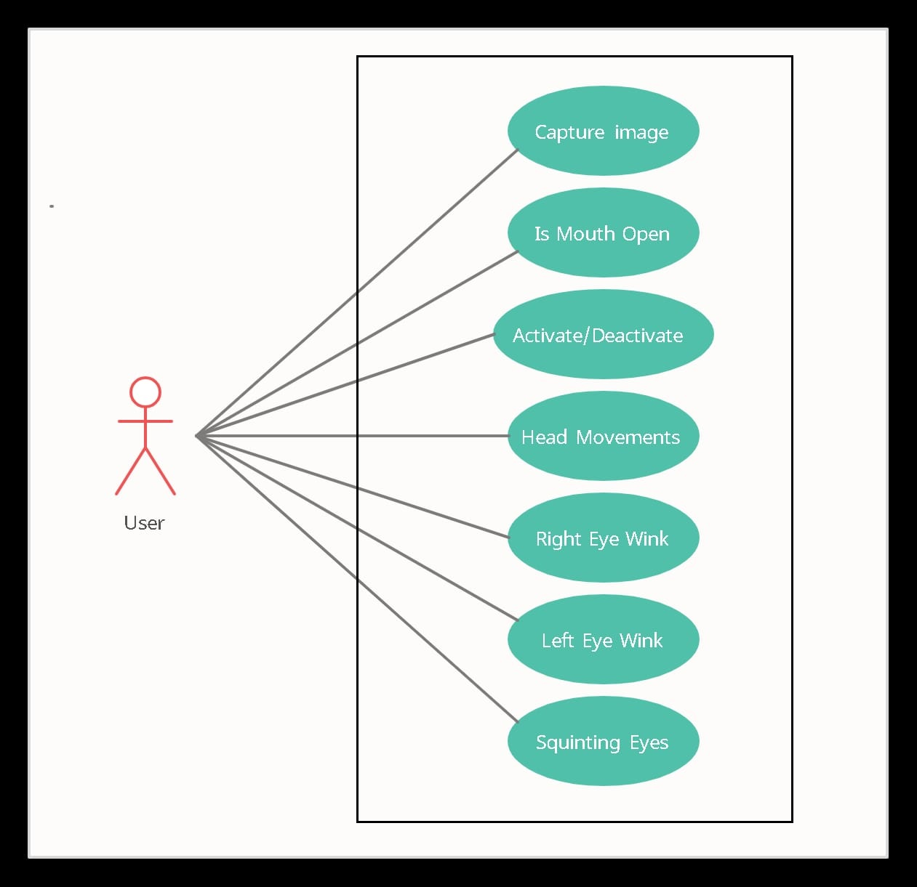
1. USE CASE DIAGRAM:
Here the user is an actor. First; the user’s image is captured using webcam and the controls of the mouse is done by the gestures of the face which acts as a virtual mouse and perform operations same as the traditional mouse
The mouse activates when the user opens the mouth then operations can be done like right eye wink is same as the right click on the mouse and same is done with the left click operation and squinting your eyes determines activates or deactivates scrolling.

Slide 18
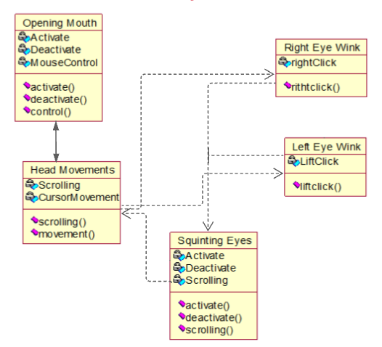
2. CLASS DIAGRAM:

Slide 19
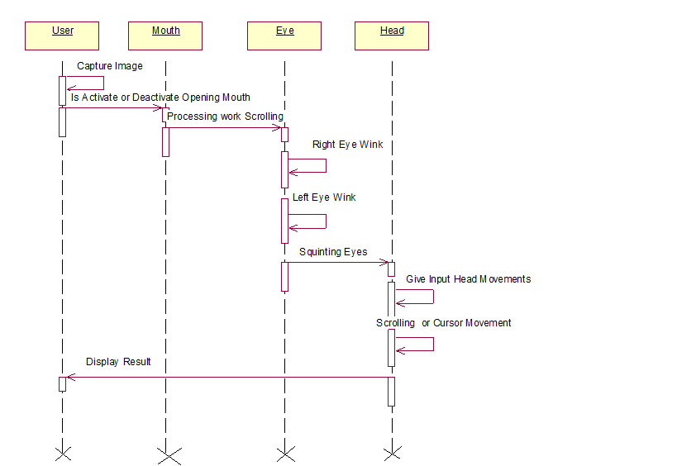
3. SEQUENCE DIAGRAM:

Slide 20
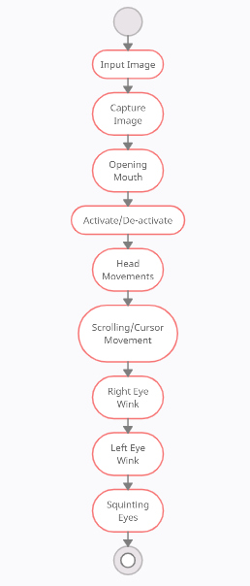
4. ACTIVITY DIAGRAM:

Slide 21
SAMPLE CODE:
import numpy as np
# Returns EAR given eye landmarks
def eye_aspect_ratio(eye):
# Compute the euclidean distances between the two sets of
# vertical eye landmarks (x, y)-coordinates
A = np.linalg.norm(eye[1] - eye[5])
B = np.linalg.norm(eye[2] - eye[4])
# Compute the euclidean distance between the horizontal
# eye landmark (x, y)-coordinates
C = np.linalg.norm(eye[0] - eye[3])
# Compute the eye aspect ratio
ear = (A + B) / (2.0 * C)
# Return the eye aspect ratio
return ear

Slide 22
# Returns MAR given eye landmarks
def mouth_aspect_ratio(mouth):
# Compute the euclidean distances between the three sets
# of vertical mouth landmarks (x, y)-coordinates
A = np.linalg.norm(mouth[13] - mouth[19])
B = np.linalg.norm(mouth[14] - mouth[18])
C = np.linalg.norm(mouth[15] - mouth[17])
# Compute the euclidean distance between the horizontal
# mouth landmarks (x, y)-coordinates
D = np.linalg.norm(mouth[12] - mouth[16])
# Compute the mouth aspect ratio
mar = (A + B + C) / (2 * D)
# Return the mouth aspect ratio
return mar
# Return direction given the nose and anchor points.
def direction(nose_point, anchor_point, w, h, multiple=1):
nx, ny = nose_point
x, y = anchor_point
if nx > x + multiple * w:
return 'right'
elif nx < x - multiple * w:
return 'left'

Slide 23
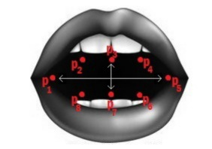
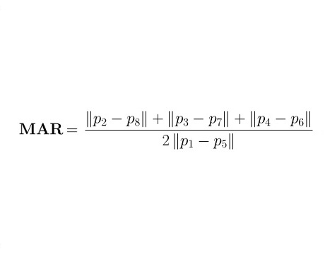
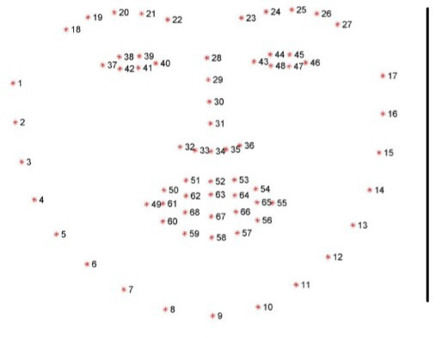
if ny > y + multiple * h:
return 'down'
elif ny < y - multiple * h:
return 'up'
return ‘-’

Slide 24
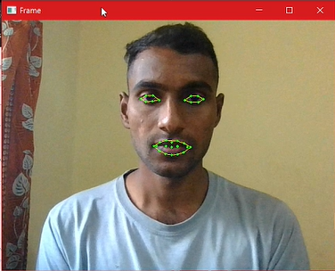
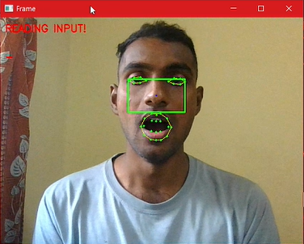
RESULT:
FACE DETECTION
ACTIVATION

Slide 25
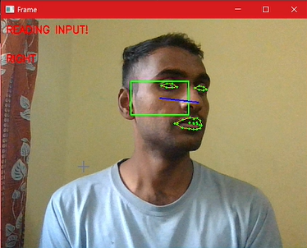
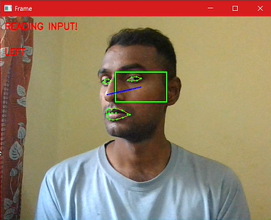
RIGHT
LEFT

Slide 26
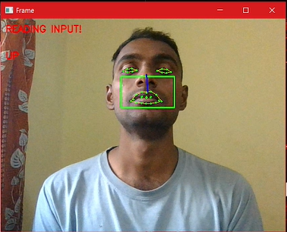
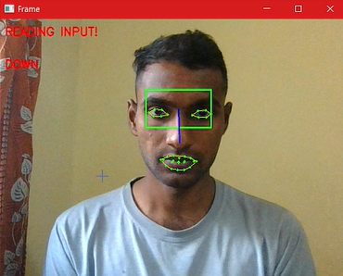
UP
DOWN

Slide 27
CONCLUSION:
A system that facilitates contactless control of mouse is developed and tested. It has an easy and wide application. Easy mouse cursor movement using face and switching between modes using eyes to enable or disable scrolling. Blinking to click. It has a wide range of applications. It can be used for physically disabled people in their education as this would empower them to type instead of writing without hand. This will lead to job opportunities for disabled people.

Slide 28
FUTURE ENHANCEMENTS:
This project focused on the analysis of the development of hands-free PC control - Controlling mouse cursor movements using human eye/face application in all aspects. Initially, the problem domain was identified and existing commercial products that fall in a similar area were compared and contrasted by evaluating their features and deficiencies. The usability of the system is very high, especially for its use with desktop applications. It exhibits accuracy and speed, which are sufficient for many real time applications and which allow handicapped users to enjoy many compute activities. In fact, it was possible to completely simulate a mouse without the use of the hands. However, after having tested the system, in future we tend to add additional functionality for speech recognition which we would help disabled enter password’s/or type and document verbally.

Slide 29
REFERENCES:
“An eye tracking algorithm based on Hough transform” https://ieeexplore.ieee.org/document/8408915/ (12.5.2018)
Balamurugan, P., J. Santhosh, and G. Arul Kumaran. "HANDMOTION BASED MOUSE CURSOR CONTROL USING IMAGEPROCESSING TECHNIQUE." Journal of Critical Reviews 7.4(2020): 181-185.
IEEE paper on “Differences in the infrared bright pupil response of human eyes” by Karlene Nguyen, Cindy Wagner, David Koons, Myron Flickner (2009
Kalas, M. S. (2014). Real Time Face Detect ion and Tracking Using OPENCV. international journal of soft computing and Artificial Intelligence, 2(1), 41-44.
Soukupová, Tereza, and Jan Cech. "Eye blink detect ion using facial landmarks." 21st computer vision winter workshop, RimskeToplice,Slovenia. 2016.

Slide 30


